Slide 1
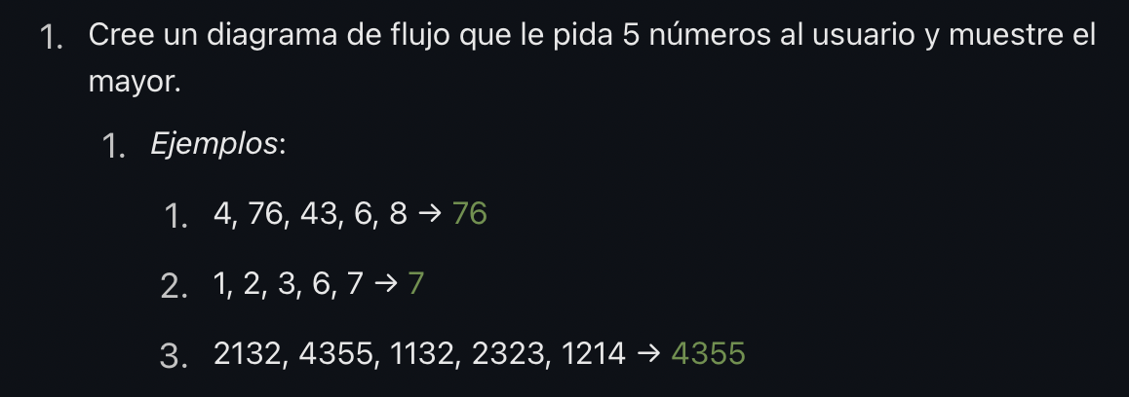
Start
Counter = 1
Counter
IS
Counter <=5
Yes
Input Number
Print Biggest_Number
No
IS Counter=1
Yes
No
Biggest_Number
= Number
No
IS Biggest_Number
< Number?
Yes
Biggest_Number
= Number
End
Counter = counter +1

Slide 2
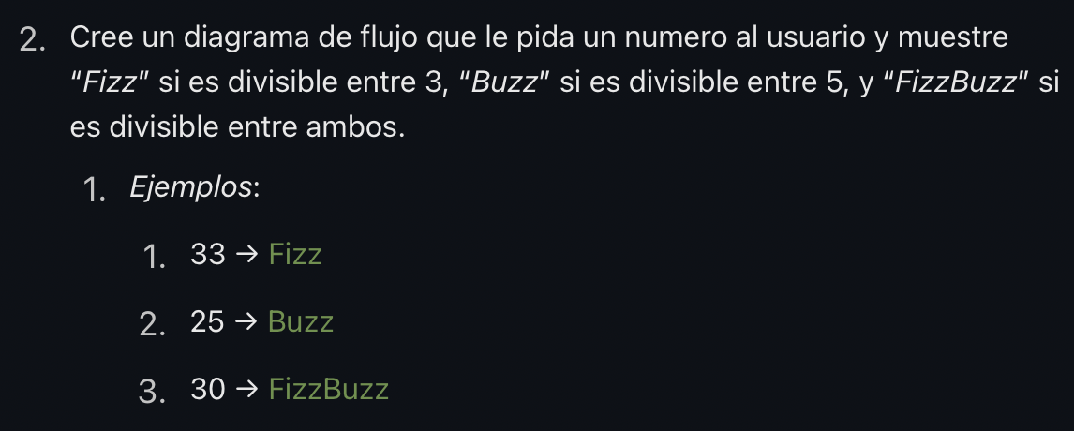
Start
Input Number
Number
Is
Number MOD 3=0
No
Yes
Div3=“N”
Div3=“Y”
Is
Number MOD 5=0
Yes
End
No
Div5=“Y”
Print “Fizz”
Div5=“N”
Yes
Is
Div3=“Y” AND Div5=“N”
Both=“Y”
Is
Div3=“Y” AND Div5=“Y”
Yes
Both=“N”
No
Print “Buzz”
No
End
Yes
Is
Div3=“N” AND Div5=“Y”
No
Is
Both=Y”
Print “FizzBuzz”
Yes

Slide 3

No
Counter = 1
Sum = 0
Counter
IS
Counter <=100
Yes
Input Number
Start
Sum= Sum + Number
Counter = counter +1
Print Sum
End

Slide 4
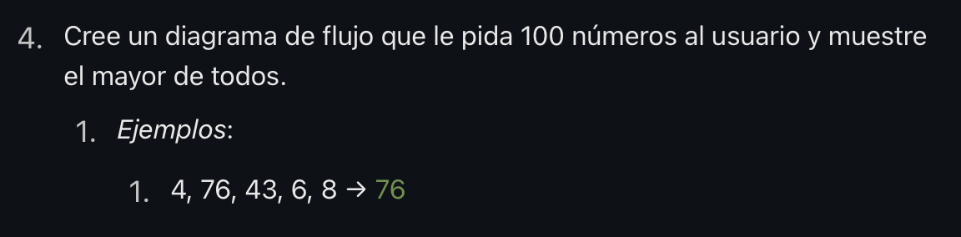
Start
Counter = 1
Counter
IS
Counter <=100
Yes
Input Number
Print Biggest_Number
No
IS Counter=1
Yes
No
Biggest_Number
= Number
No
IS Biggest_Number
< Number?
Yes
Biggest_Number
= Number
End
Counter = counter +1

